Slide 1

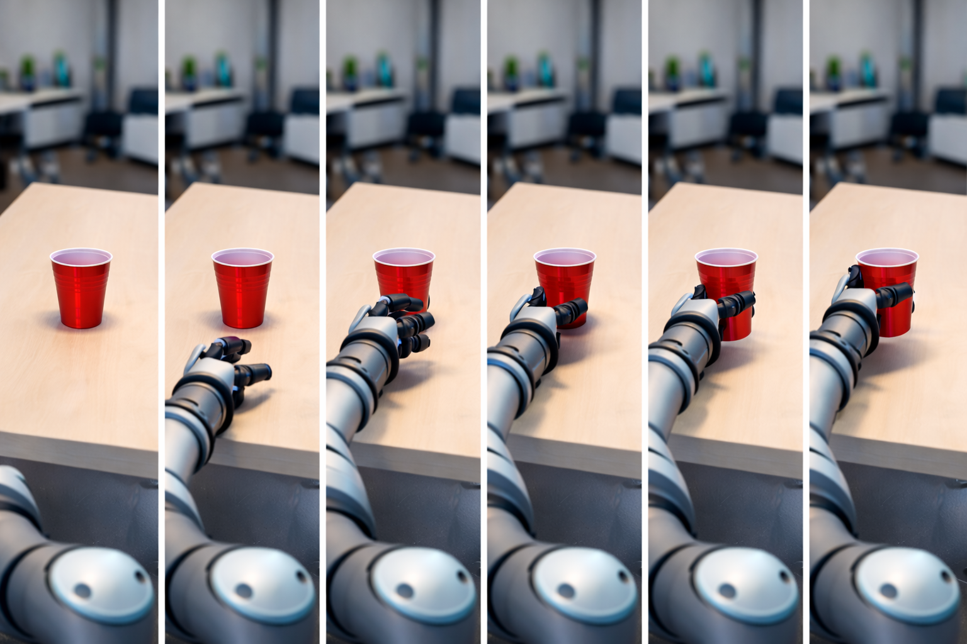



$$task 1$$
$$task 2$$
…
…
$$task N$$
“robot picks up red cup”
Video Language Model

